Slide 1
Multivariate Analysis and NLP
ITA17 Natural Language Processing with Deep Learning
Lecture #5 (2024/10/21)
Yuichi Yaguchi, Ph.D (CSE)

Slide 2
What is multivariate analysis?
A general term for methods of analyzing data consisting of multiple variables
Regression analysis: Explaining the value of a variable of interest using multiple quantities
Principal component analysis: Composing a small number of characteristic quantities that explain the whole
Discriminant analysis: Categorizing based on differences in characteristic quantities
Cluster analysis: Composing clusters based on differences in characteristic quantities
Time series analysis: Describing phenomena that change over time
Fundamentals of methods used in machine learning
Supervised problems: Regression analysis (quantitative data), discriminant analysis (qualitative data)
Unsupervised problems: Principal component analysis, cluster analysis
Notes:
複数の変数からなるデータを分析する方法の総称
回帰分析：複数の量を用いて、注目する変数の値を説明する
主成分分析：全体を説明する少数の特徴量を構成する
判別分析：特徴量の差異に基づいて分類する
クラスタ分析：特徴量の差異に基づいてクラスタを構成する
時系列分析：時間とともに変化する現象を記述する
機械学習で用いられる手法の基礎
教師あり学習の問題：回帰分析（量的データ）、判別分析（質的データ)
教師なし学習の問題：主成分分析、クラスタ分析

Slide 3
Hayashi’s Quantification Method
I : Regression Analysis (Linear, Multiple, Logistic, etc.)
II : Discriminant Analysis (LDA, QDA, MDA etc.)
III : Principal Component Analysis or Factor Analysis (PCA, SVD, LSA, etc.)
IV : Multi-dimensional Scaling (MDA, t-SNE, etc.)
III and IV includes corresponding theory

Slide 4
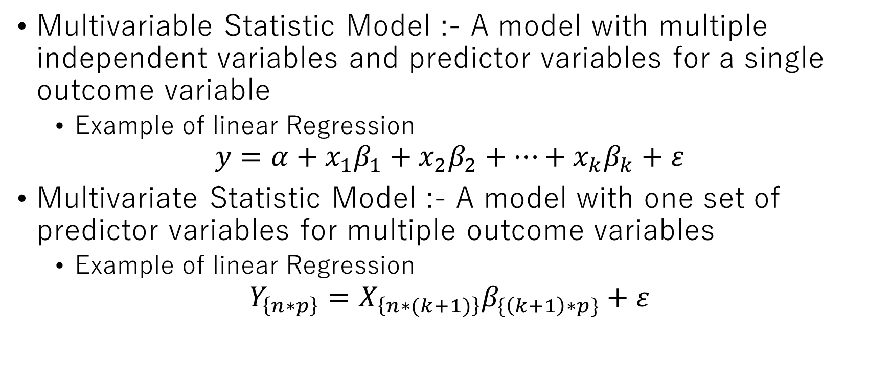
Multivariable vs Multivariate
Multivariable Statistic Model :- A model with multiple independent variables and predictor variables for a single outcome variable
Example of linear Regression
$$y=α+x_{1}β_{1}+x_{2}β_{2}+…+x_{k}β_{k}+ε$$
Multivariate Statistic Model :- A model with one set of predictor variables for multiple outcome variables
Example of linear Regression
$$Y_{\left\{n∗p\right\}}=X_{\left\{n∗(k+1)\right\}}β_{\{\left(k+1\right)∗p\}}+ε$$

Slide 5
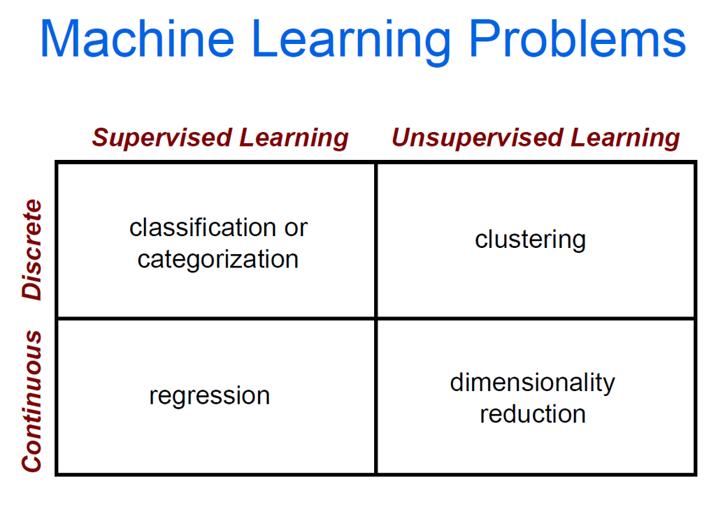

Slide 7
Supervised (Inductive) Learning
Given: examples of a function (X, F(X))
Predict: function F(X) for new examples X
- Discrete F(X): Classification
- Continuous F(X): Regression
- F(X) = Probability(X): Probability estimation
Regression: Create a model to represent (labeled) data

Slide 8
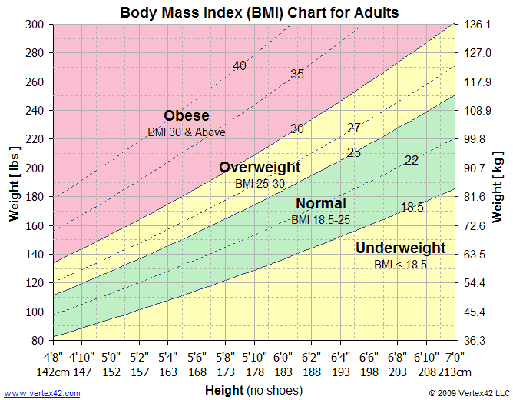
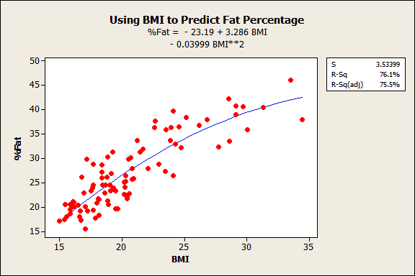
Deterministic Models
Hypothesize Exact Relationships
Suitable When Prediction Error is Negligible
Example: Body mass index (BMI) is measure of body fat based
Metric Formula: BMI = Weight [kg] / (Height [m])^2
Non-metric Formula: BMI = Weight [lb] x 703 / (Height [in])^2

Slide 9
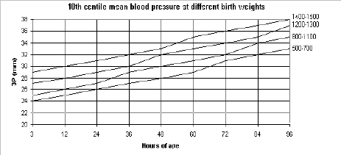
Probabilistic Models
Hypothesize 2 Components
Deterministic (representative value like mean)
Random Error
Example: Systolic blood pressure of newborns Is 6 Times the Age in days + Random Error
SBP = 6xage(d) + ε
Random Error May Be Due to Factors Other Than age in days (e.g. Birthweight)

Slide 10
Types of Probabilistic Models
Probabilistic Models
Regression Models
Correlation Models
Other Models
Notes:
7

Slide 11
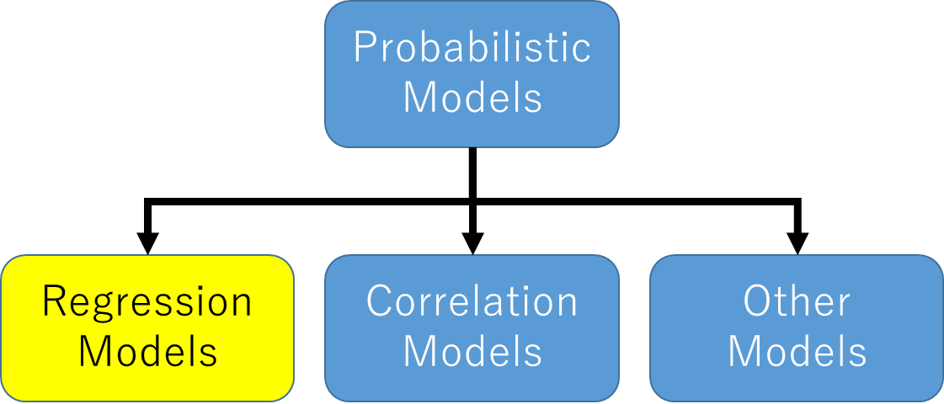
Regression Models
Relationship between - one dependent variable and - explanatory variable(s)
Use equation to set up relationship
Numerical Dependent (Response) Variable
One or More Numerical or Categorical Independent (Explanatory) Variables
Used Mainly for Prediction & Estimation
Steps:
Hypothesize Deterministic Component
Estimate Unknown Parameters
Specify Probability Distribution of Random Error Term
Estimate Standard Deviation of Error
Evaluate the fitted Model
Use Model for Prediction & Estimation
Notes:
7

Slide 12
Types of Regression Models
1 Explanatory
Regression
2+ Explanatory
Variable
Models
Variables
Simple
Multiple
Non-
Non-
Linear
Linear
Linear
Linear
Notes:
18
This teleology is based on the number of explanatory variables & nature of relationship between X & Y.

Slide 13
Linear Regression Model
This lecture introduces the models that fit a linear equation to observed data between two variables (or among multiple variables).
How to fit a linear equation (line)?
How to understand the least squares lines?
Multiple regression.
Notes:
26

Slide 14
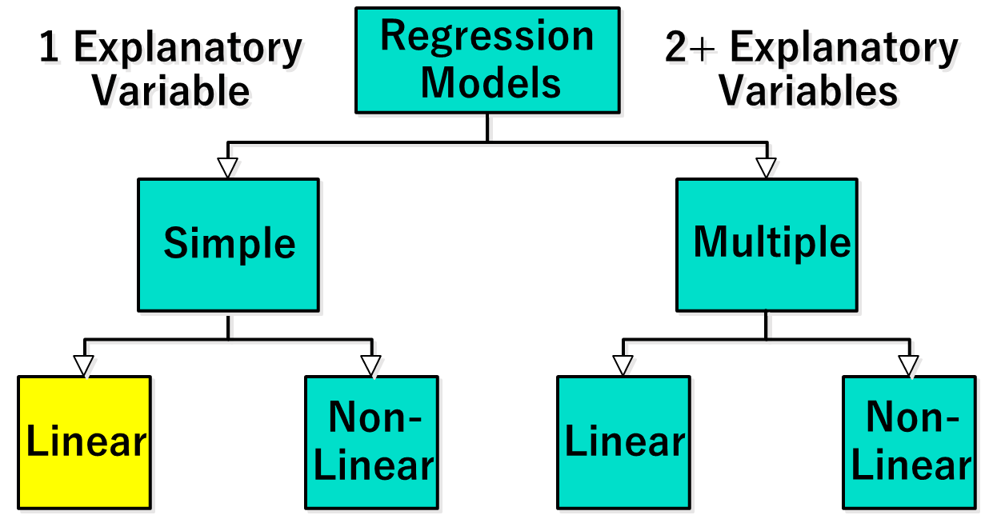
Linear Regression Model
Relationship Between Variables is a Linear Function
Population Y-Intercept
Population Slope
Random Error
Y
=
β
+
β
X
+
ε
i
0
1
i
i
Dependent (Response) Variable (e.g., CD+ c.)
Independent (Explanatory) Variable (e.g., Years s. serocon.)

Slide 15
Linear Equations
Notes:
28

Slide 16
Population & Sample Regression Models
Notes:
30

Slide 17
Population & Sample Regression Models
Population
☺
☺
☺
☺
☺
Notes:
31

Slide 18
Population & Sample Regression Models
Population
Unknown Relationship
☺
☺
☺
☺
☺
Notes:
32

Slide 19
Population & Sample Regression Models
Population
Random Sample
Unknown Relationship
☺
☺
☺
☺
☺
☺
☺
Notes:
33

Slide 20
Population & Sample Regression Models
Population
Random Sample
Unknown Relationship
☺
☺
☺
☺
☺
☺
☺
Notes:
34

Slide 21
Population Linear Regression Model
Observedvalue
ε_{i} = Random error
Observed value
Notes:
35

Slide 22
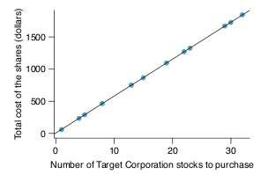
A Perfect Linear Relationship
Requests from twelve separate buyers were simultaneously placed with a trading company to purchase Target Corporation stock (April 26th, 2012).

Slide 23
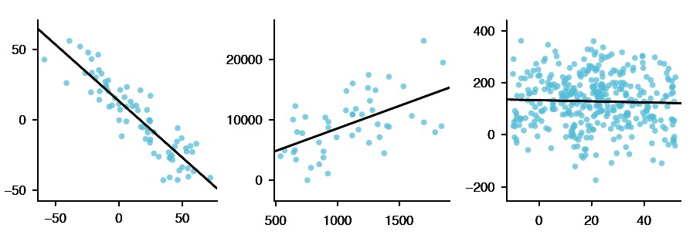
Linear Models for Three Data Sets
Three data sets where a linear model may be useful even though the data do not all fall exactly on the line.

Slide 24
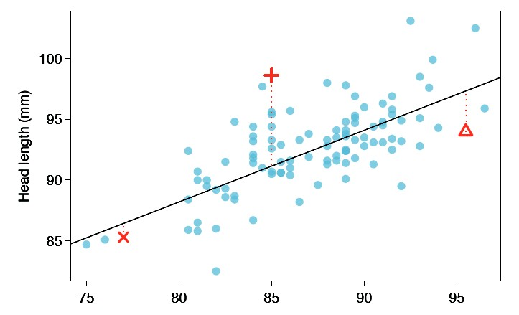
Fitting a Line by Eye
How to describe the differences between the data and the estimated?
6

Slide 25
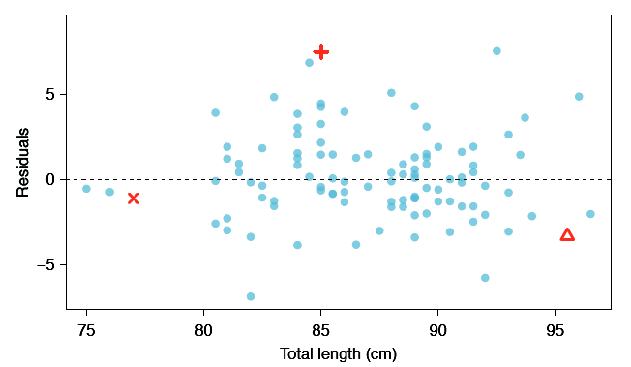
Residual Plot
Residuals are the leftover variation in the data after accounting for the model fit: Data = Fit + Residual
7

Slide 26
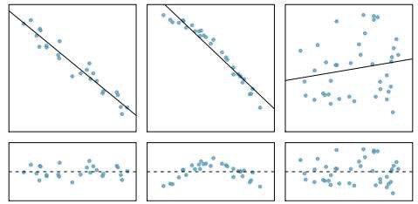
Purposes of Residual Plot
Residuals are helpful in evaluating how well a linear model fits a data set.
8

Slide 27
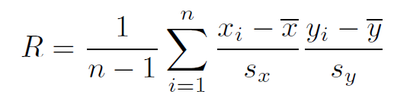
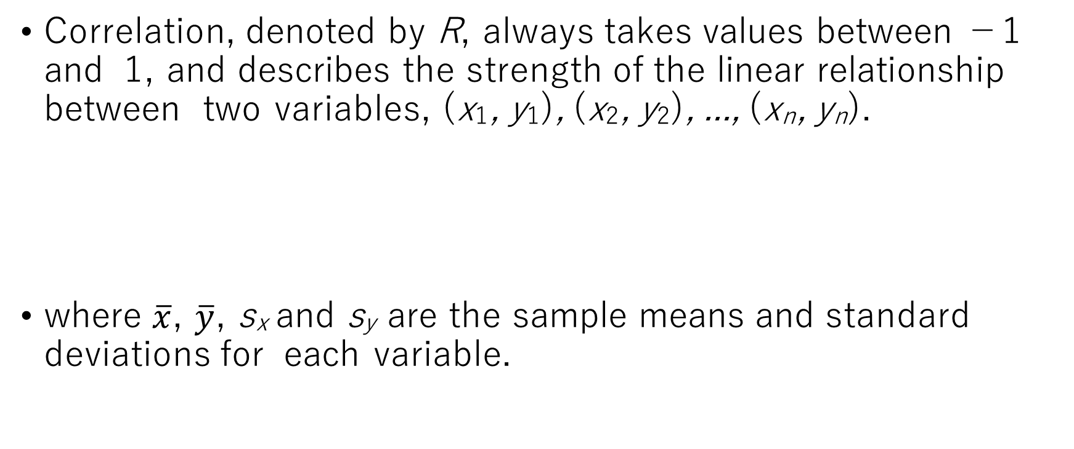
Correlation
Correlation, denoted by R, always takes values between −1 and 1, and describes the strength of the linear relationship between two variables, (x₁, y₁), (x₂, y₂), ..., (x_{n}, y_{n}).
where $\overline{x}$, $\overline{y}$, s_{x} and s_{y} are the sample means and standard deviations for each variable.
9

Slide 28
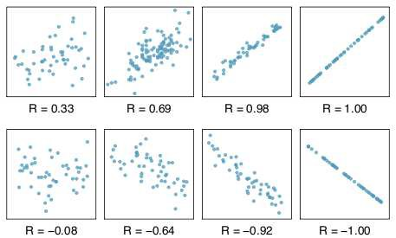
Sample Scatterplots and Their Correlations

Slide 29
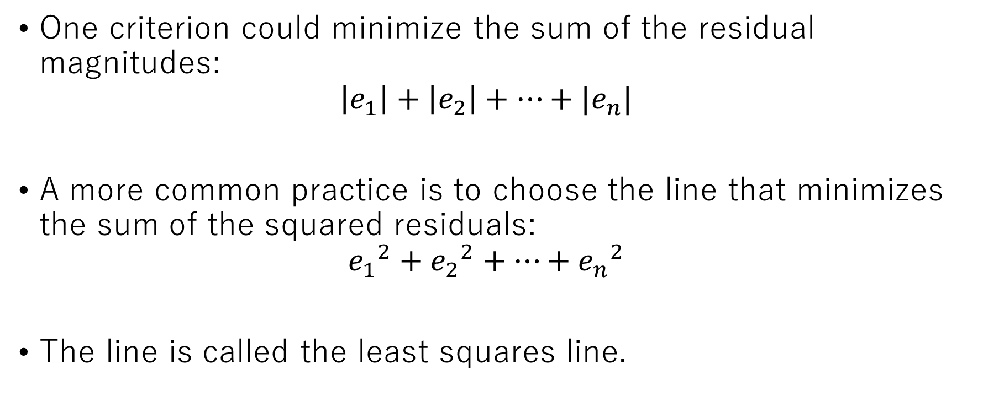
Least Squares Regression
One criterion could minimize the sum of the residual magnitudes:
$$\left|e_{1}\right|+\left|e_{2}\right|+⋯+|e_{n}|$$
A more common practice is to choose the line that minimizes the sum of the squared residuals:
$${e_{1}}^{2}+{e_{2}}^{2}+⋯+{e_{n}}^{2}$$
The line is called the least squares line.

Slide 30
Scatter plot
1. Plot of All (X_{i}, Y_{i}) Pairs
2. Suggests How Well Model Will Fit
Y
60
40
20
0
X
0
20
40
60

Slide 31
Thinking Challenge
How would you draw a line through the points?
How do you determine which line ‘fits best’?
Y
60
40
20
0
X
0
20
40
60
Notes:
42

Slide 32
Thinking Challenge
How would you draw a line through the points?
How do you determine which line ‘fits best’?
Slope changed
Y
60
40
20
0
X
0
20
40
60
Intercept unchanged
Notes:
42

Slide 33
Thinking Challenge
How would you draw a line through the points?
How do you determine which line ‘fits best’?
Slope unchanged
Y
60
40
20
0
X
0
20
40
60
Intercept changed
Notes:
42

Slide 34
Thinking Challenge
How would you draw a line through the points?
How do you determine which line ‘fits best’?
Slope changed
Y
60
40
20
0
X
0
20
40
60
Intercept changed
Notes:
42

Slide 35
Least Squares
‘Best Fit’ Means Difference Between Actual Y Values & Predicted Y Values Are a Minimum. But Positive Differences Off-Set Negative ones
Notes:
49

Slide 36
Least Squares
‘Best Fit’ Means Difference Between Actual Y Values & Predicted Y Values is a Minimum. But Positive Differences Off-Set Negative ones. So square errors!
Notes:
50

Slide 37
Least Squares
‘Best Fit’ Means Difference Between Actual Y Values & Predicted Y Values Are a Minimum. But Positive Differences Off-Set Negative. So square errors!
LS Minimizes the Sum of the Squared Differences (errors) (SSE)
Notes:
51

Slide 38
Conditions for the Least Squares Line
Linearity.
The data should show a linear trend.
Nearly normal residuals.
Generally the residuals must be nearly normal.
Constant variability.
The variability of points around the least squares line remains roughly constant.

Slide 39
Least Squares Graphically
Notes:
52

Slide 40
Coefficient Equations
Prediction equation
Sample slope
Sample Y - intercept

Slide 41
Derivation of Parameters (1)
Least Squares (L-S): Minimize squared error

Slide 42
Derivation of Parameters (1)
Least Squares (L-S): Minimize squared error

Slide 43
Computation Table
Notes:
54

Slide 44
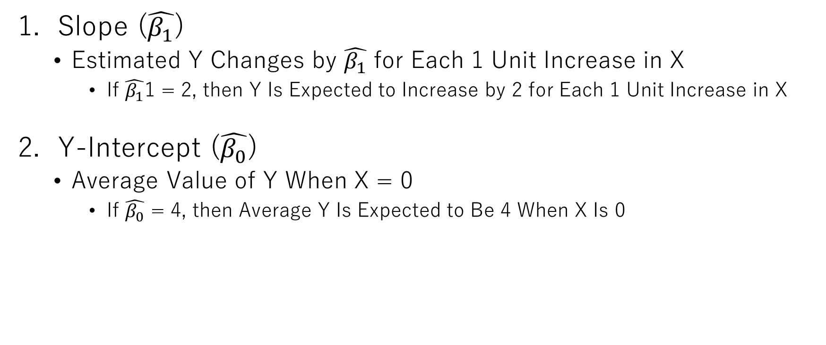
Interpretation of Coefficients
Slope ($\hat{β_{1}}$)
Estimated Y Changes by $\hat{β_{1}}$ for Each 1 Unit Increase in X
If $\hat{β_{1}}$1 = 2, then Y Is Expected to Increase by 2 for Each 1 Unit Increase in X
Y-Intercept ($\hat{β_{0}}$)
Average Value of Y When X = 0
If $\hat{β_{0}}$ = 4, then Average Y Is Expected to Be 4 When X Is 0

Slide 45
Multiple regression
Multiple regression extends simple two-variable regression to the case that still has one response but many predictors (denoted x₁, x₂, ..., x_{k} ).
y = b₀ + b₁x₁ + b₂x₂ + · · · + b_{k} x_{k}
The method is motivated by scenarios where many variables may be simultaneously connected to an output.

Slide 46
An Example of Video Game Auction Data Set
 | price cond new |  | stock phot0 | duration | wheels
1 | 51.55 | 1 | 1 | 3 | 1
2 | 37.04 | 0 | 1 | 7 | 1
140 | 38.76 | 0 | 0 | 7 | 0
141 | 54.51 | 1 | 1 | 1 | 2

Slide 47
Variable and Their Descriptions
variable
descriptions
price cond new
stock photo duration wheels
final auction price plus shipping cost in USD
1 when the game is new and 0 if the game is used
1 if the photo used in the auction was a stock photo, else 0 the length of the auction in days
the number of wheels included in the auction

Slide 48
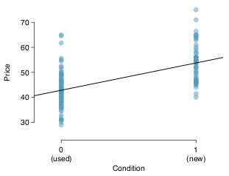
A Single Variable Model for the Aution Data
Lets fit a linear regression model with the games condition as a predictor of auction price. The model may be written as:
price = 42.87 + 10.90 × cond new

Slide 49
Including All Variables in a Model
Sometimes there are relationships between predictor variables. For instance, new game sold tend to come with more Wii wheels, which may have led to higher prices for those auctions.
If the auctions were under 4 variables, x₁(condnew),x₂(stockphoto), x₃(duration), and x₄(wheels), there will be:
y = 36.21 + 5.16x₁ + 1.08x₂ − 0.03x₃ + 7.26x₄
Why might there be a difference?

Slide 50
Model Selection
The backward-elimination strategy begins with the largest model and eliminates variables one-by-one until we are satisfied that all remaining variables are important to the model.
The forward-selection strategy starts with no variables included in the model, then it adds in variables according to their importance until no other important variables are found.
Notes:
後方排除法は、最も大きなモデルから開始し、残りのすべての変数がモデルにとって重要であると納得できるまで、変数を1つずつ排除していきます。
前方選択法は、モデルに変数が含まれていない状態から開始し、重要度に従って変数を追加し、他の重要な変数が発見されなくなるまで続けます。

Slide 51
The Logistic Regression Model
The "logit" model solves these problems: ln[p/(1-p)] = α + βX + e
p is the probability that the event Y occurs, p(Y=1)
p/(1-p) is the "odds ratio"
ln[p/(1-p)] is the log odds ratio, or "logit"
Notes:
ロジットモデルは、これらの問題を解決します。ln[p/(1-p)] =  + X + ep は、事象Yが発生する確率、p(Y=1)p/(1-p) は「オッズ比」ln[p/(1-p)] は対数オッズ比、または「ロジット」

Slide 52
Why use logistic regression?
There are many important research topics for which the dependent variable is "limited."
For example: voting, morbidity or mortality, and participation data is not continuous or distributed normally.
Binary logistic regression is a type of regression analysis where the dependent variable is a dummy variable: coded 0 (did not vote) or 1(did vote)
Notes:
従属変数が「限定されている」重要な研究テーマは数多くあります。
例えば、投票、罹患率または死亡率、参加データなどは連続的ではなく、正規分布もしません。
二値ロジスティック回帰は、従属変数がダミー変数である回帰分析の一種です。ダミー変数は、0（投票しなかった）または1（投票した）としてコード化されます。

Slide 53
More:
The logistic distribution constrains the estimated probabilities to lie between 0 and 1.
The estimated probability is: p = 1/[1 + exp(-α - β X)]
if you let α + β X =0, then p = .50
as α + β X gets really big, p approaches 1
as α + β X gets really small, p approaches 0
Notes:
さらに：ロジスティック分布は、推定確率を0から1の間に制限します。
推定確率は次のとおりです。p = 1/[1 + exp(- -  X)]
 +  X = 0 とすると、p = .50
 +  X が非常に大きくなると、p は 1 に近づく
 +  X が非常に小さくなると、p は 0 に近づく

Slide 54
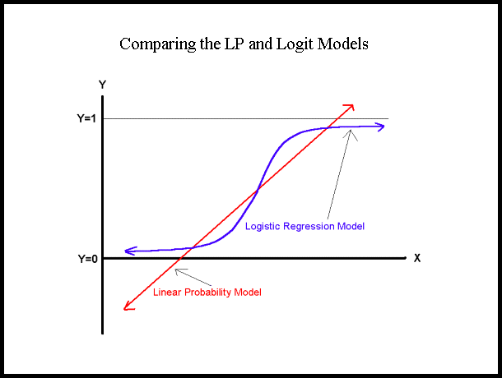

Slide 55
Comparing LP and Logit Models
Y
LP Model
1
Logit Model
0
X

Slide 56
Maximum Likelihood Estimation (MLE)
MLE is a statistical method for estimating the coefficients of a model.
The likelihood function (L) measures the probability of observing the particular set of dependent variable values (p₁, p₂, ..., p_{n}) that occur in the sample: L = Prob (p₁* p₂* * * p_{n})
The higher the L, the higher the probability of observing the ps in the sample.
Notes:
MLEは、モデルの係数を推定するための統計的手法である。
尤度関数（L）は、サンプルで発生する特定の従属変数値の集合（p1、p2、...、pn）を観測する確率を測定する。
Lが高いほど、サンプルでpsを観測する確率が高い。

Slide 57
MLE involves finding the coefficients (α, β) that makes the log of the likelihood function (LL < 0) as large as possible
Or, finds the coefficients that make -2 times the log of the likelihood function (-2LL) as small as possible
The maximum likelihood estimates solve the following condition: {Y - p(Y=1)}X_{i} = 0 summed over all observations, i = 1,…,n
Notes:
MLEは、尤度関数の対数（LL < 0）をできるだけ大きくする係数（α、β）を見つけること、
または-2倍の尤度関数の対数（-2LL）をできるだけ小さくする係数を見つけることを意味します。
最尤推定値は、以下の条件を満たします。{Y - p(Y=1)}Xi = 0 すべての観測値について合計、i = 1,…,n

Slide 58
Interpreting Coefficients
Since: ln[p/(1-p)] = α + βX + e
The slope coefficient (β) is interpreted as the rate of change in the "log odds" as X changes … not very useful.
Since: p = 1/[1 + exp(-α - β X)] The marginal effect of a change in X on the probability is: p/X = f(β X) β
Notes:
Since: ln[p/(1-p)] =  + X + e 傾き係数（）は、X が変化するときの「対数オッズ」の変化率と解釈されるが、あまり有用ではない。
なぜなら、p = 1/[1 + exp(- -  X)] であるからだ。X の変化による確率の限界効果は、p/X = f( X)  である。

Slide 59
An interpretation of the logit coefficient which is usually more intuitive is the "odds ratio"
Since: [p/(1-p)] = exp(α + βX)
exp(β) is the effect of the independent variable on the "odds ratio"
Notes:
ロジット係数の解釈として、通常、より直感的なものは「オッズ比」である。なぜなら、[p/(1-p)] = exp( + X)
exp()は「オッズ比」に対する独立変数の効果である。

Slide 60
From SPSS Output:
“Households with pets are 1.933 times more likely to evacuate than those without pets.”
Notes:
「ペットを飼っている世帯は、飼っていない世帯よりも1.933倍避難する可能性が高い。」

Slide 61
Hypothesis Testing
The Wald statistic for the β coefficient is: Wald = [β /s.e._{B}]² which is distributed chi-square with 1 degree of freedom.
The "Partial R" (in SPSS output) is R = {[(Wald-2)/(-2LL(α)]}^{1/2}
Notes:
係数のWald統計量は、Wald = [ /s.e.B]2であり、これは自由度1のカイ二乗分布に従う
。「偏R」（SPSS出力）は、R = {[(Wald-2)/(-2LL()]}1/2

Slide 62
An Example:

Slide 64
Mahalanobis Distance: General Concepts
Mahalanobis distance is most commonly used as a multivariate outlier statistic.
The metric essentially addresses the question of whether a particular case would be considered an outlier relative to a particular set of group data.
This measure is recommended for examining data profiles.
Initially the simplest and most commonly employed method to examine profiles is that of correlation by correlating the sample’s scores with the mean scores for a selected group. The problem with this approach is that it incorporates only the group mean values into the computation leaving the variability within each measure and the correlations and variability between measures are not accounted for.
Notes:
マハラノビス距離は、多変量外れ値統計として最も一般的に使用されています。この測定基準は、特定のケースが特定のグループデータと比較して外れ値と見なされるかどうかという問題を本質的に扱います。この測定基準は、データプロファイルの調査に推奨されます。プロファイルを調べる最も単純で一般的に用いられる方法は、まずサンプルのスコアと選択したグループの平均スコアを相関させることです。このアプローチの問題点は、グループの平均値のみを計算に組み込むため、各測定値内のばらつきが考慮されず、測定値間の相関やばらつきが考慮されないことです。

Slide 65
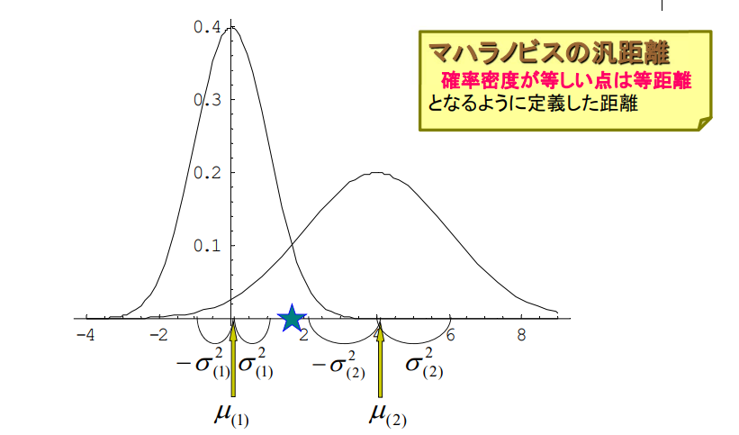
Mahalanobis Distance
Mahalanobis' distance The distance defined so that points with equal probability density are equidistant

Slide 66
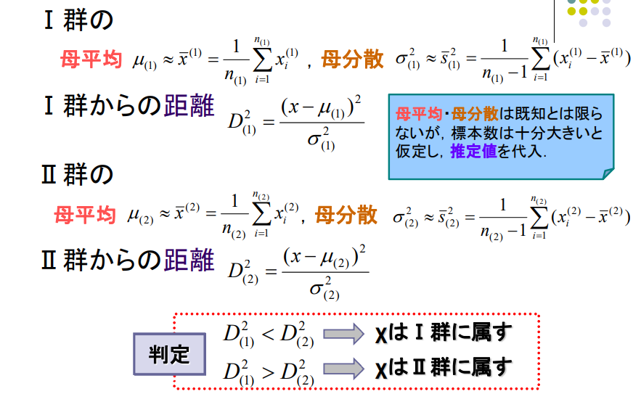
Group I
Population Mean
Population
Variance
Distance from group I
Population mean and variance is not determined but we can estimate in here.
Group II
Population Mean
Population
Variance
Distance from group II
Is belongs to I
Is belongs to II

Slide 67
Discrimination of two or more variables
A
B

Slide 68
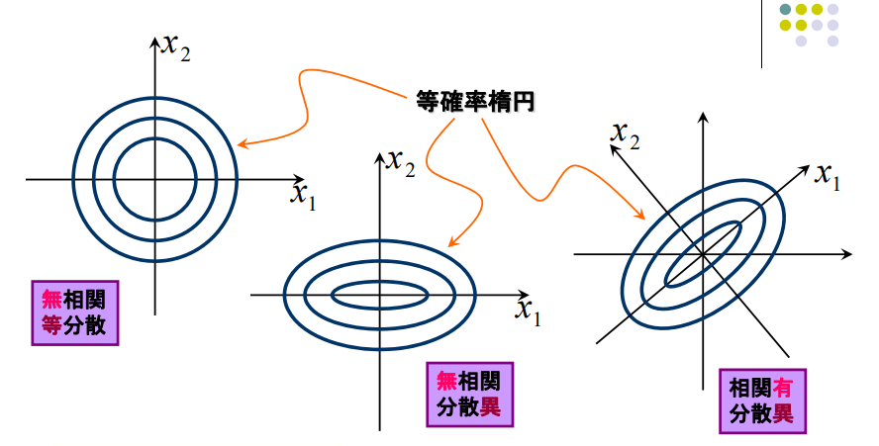
Discrimination of two or more variables
equidistant ellipse
Uncorrelated
Equal variances
Uncorrelated
Equal variances
Uncorrelated
Equal variances

Slide 69
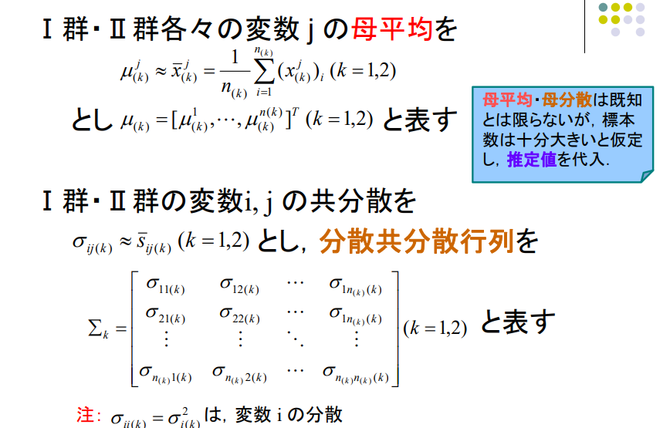
Discrimination of two or more variables
Population Mean of group I and II as:
Population Variance of group I and II as:
, and decomposition copolymerization as:

Slide 70
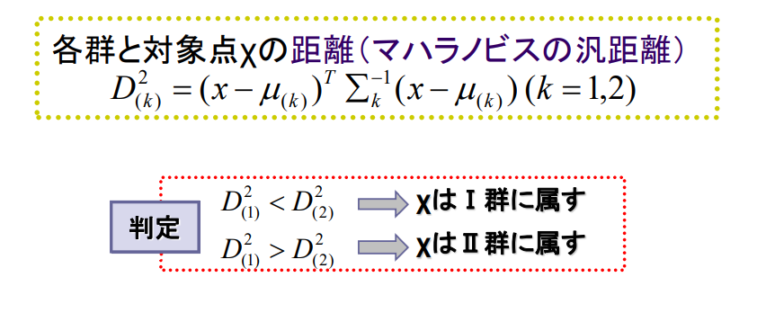
Discrimination of two or more variables
Maharanobis’ distance between each group and target x:
Is belongs to I
Is belongs to II

Slide 72
High-dimensional datasets
Range queries have very small selectivity
Surface is everything
Partitioning the space is not so easy: 2d cells if we divide each dimension once
Pair-wise distances of points are very skewed
freq
distance

Slide 73
Dimensionality Reduction
The main idea: reduce the dimensionality of the space.
Project the d-dimensional points in a k-dimensional space so that:
k << d
distances are preserved as well as possible
Solve the problem in low dimensions

Slide 74
Embeddings
Given a metric distance matrix D, embed the objects in a k-dimensional vector space using a mapping F such that
D(i,j) is close to D’(F(i),F(j))
Isometric mapping:
exact preservation of distance
Contractive mapping:
D’(F(i),F(j)) <= D(i,j)
d’ is some Lp measure

Slide 75
Principle Components Analysis
Method to optimally summarise large multi-dimensional datasets
Can find a smaller number of dimensions (ideally 2) which retain most of the useful information in the data
Builds a recipe for converting large amounts of data into a single value, called a Principle Component (PC), eg:
PC = (GeneA*10)+(GeneB*3)+(GeneC*-4)+(GeneD*-20)…

Slide 76
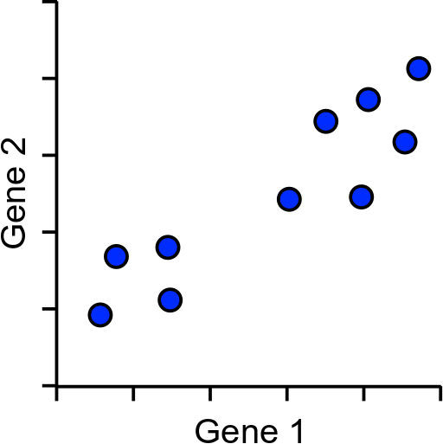
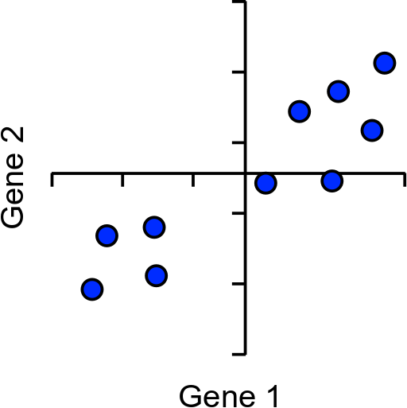
How does PCA work?
Simple example using 2 genes and 10 cells

Slide 77
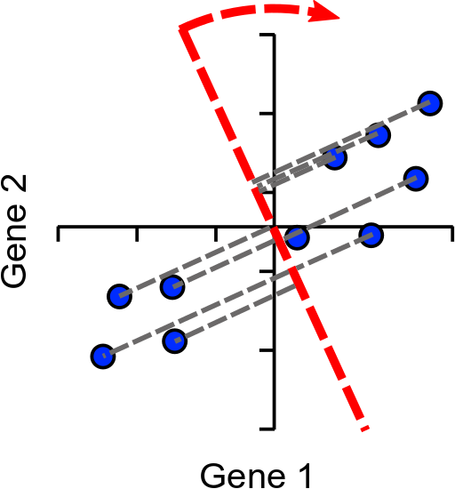
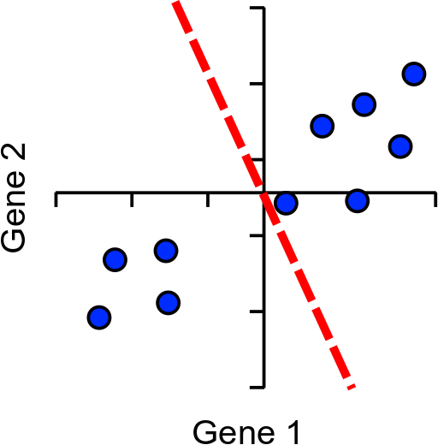
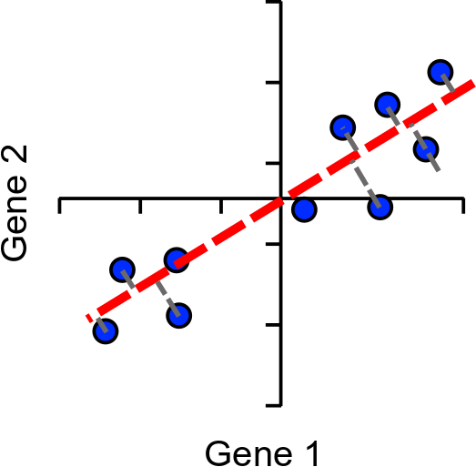
How does PCA work?
Find line of best fit, passing through the origin

Slide 78
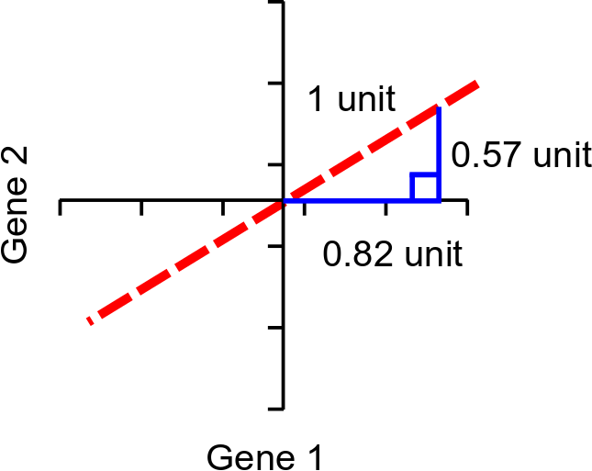
Assigning Loadings to Genes
Loadings:
Gene1 = 0.82
Gene2 = 0.57
Higher loading equals more influence on PC
Single Vector or
‘eigenvector’

Slide 79
More dimensions
The same idea extends to larger numbers of dimensions (n)
Calculation of first PC rotates in (n-1) -dimensions
Next PC is perpendicular to PC2, but rotated similarly (n-2)
Last PC is remaining perpendicular (no choice)
Same number of PCs as genes

Slide 80
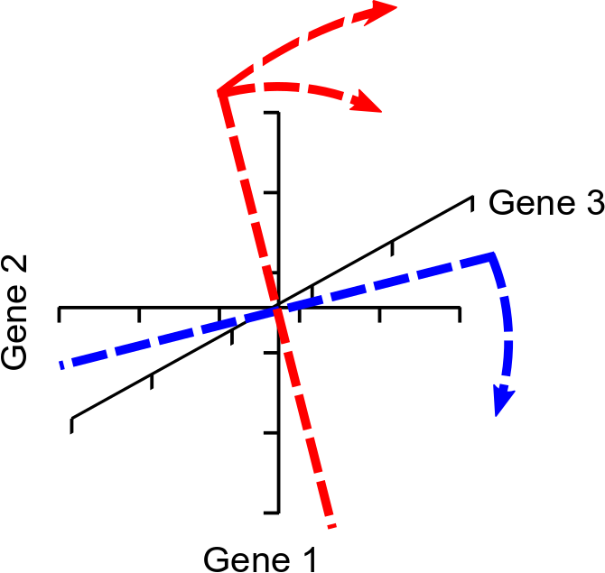
Example with 3 dimensions

Slide 81
Explaining Variance
Each PC always explains some proportion of the total variance in the data. Between them they explain everything
PC1 always explains the most
PC2 is the next highest etc. etc.
Since we only plot 2 dimensions we’d like to know that these are a good explanation
How do we calculate this?

Slide 82
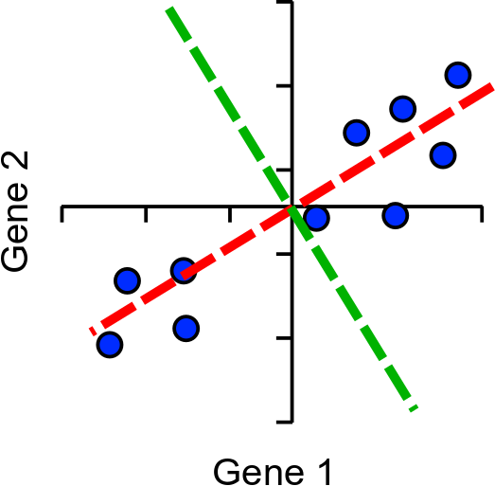
Explaining variance
Project onto PC
Calculate distance to the origin
Calculate sum of squared differences (SSD)
This is a measure of variance called the ‘eigenvalue’
Divide by (points-1) to get actual variance
PC1
PC2

Slide 83
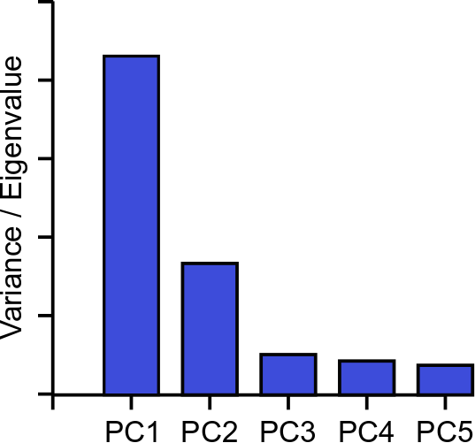
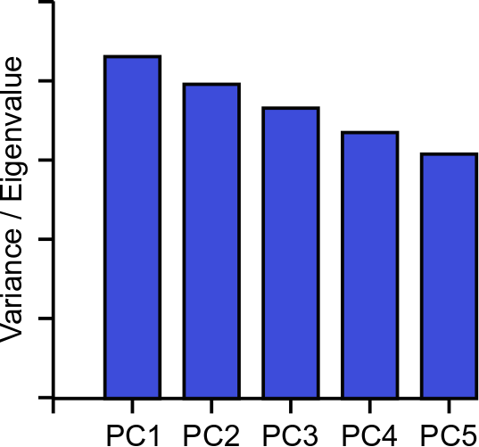
Explaining Variance – Scree Plots

Slide 84
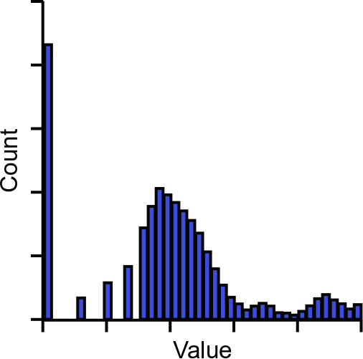
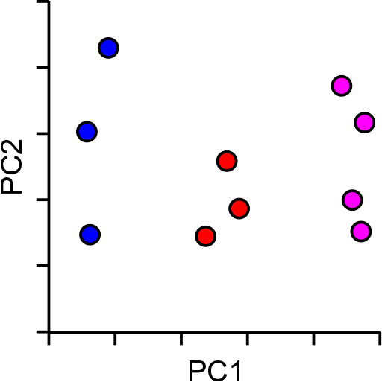
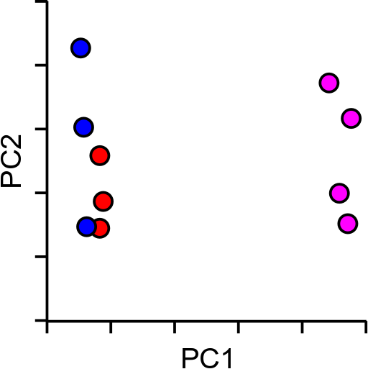
So PCA is great then?
Kind of…
Non-linear separation of values

Slide 85
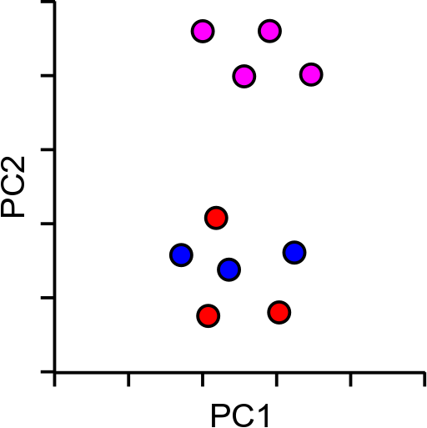
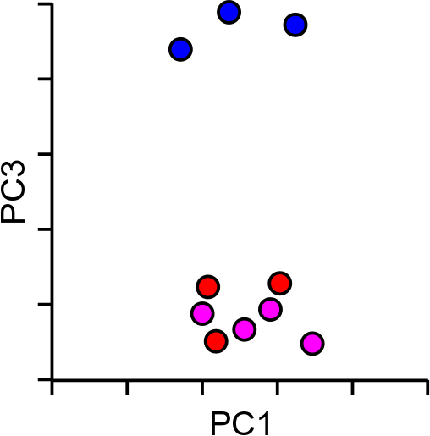
So PCA is great then?
Kind of…
Not optimised for 2-dimensions

Slide 86
Word2vec: How to represent a word
Simple representation
One hot representation :
a vector with one 1 and a lot of zeroes
ex) motel = [0 0 0 0 0 1 0 0 0 0 0 0 0 0]

Slide 87
Problem of One-Hot representation
High dimensionality
E.g.) For Google News, 13M words
Sparse
Only 1 non-zero value
Shallow representation
E.g.) motel = [0 0 0 0 0 0 1 0 0 0 0 0 0 0 0] AND
hotel = [0 0 0 0 1 0 0 0 0 0 0 0 0 0 0] = 0

Slide 88
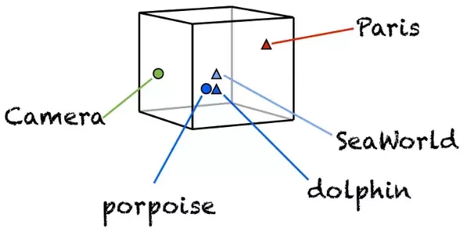
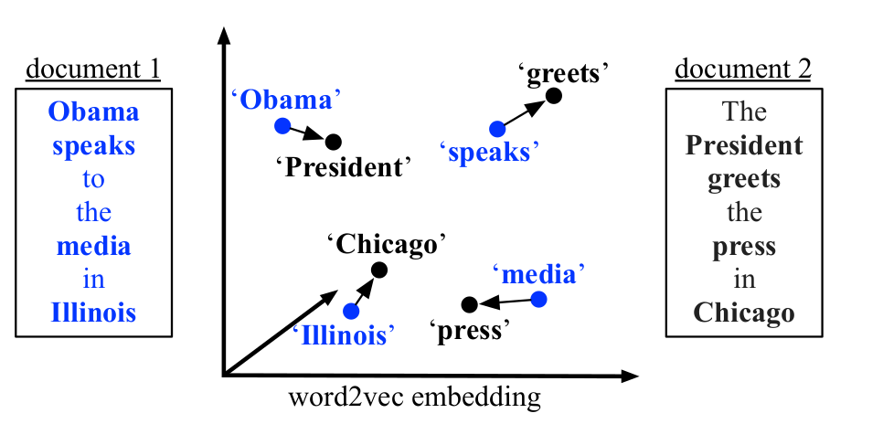
Word Embedding
Low dimensional vector representation of every word
E.g.) motel = [1.3, -1.4] and hotel = [1.2, -1.5]

Slide 89
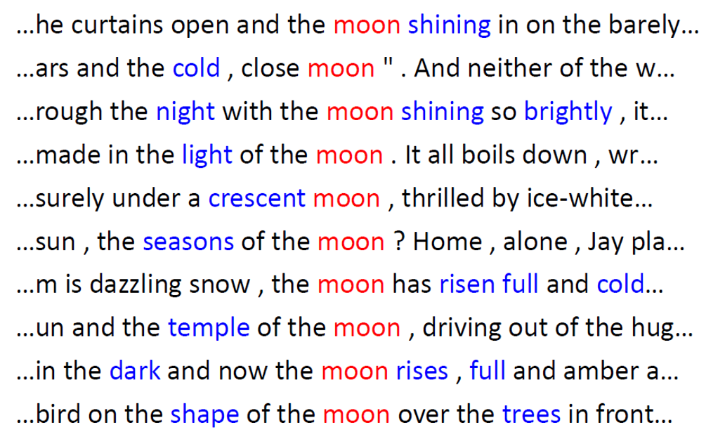
How to learn such Embedding ?
Use context information !!

Slide 90
A Naive Approach
Build a Co-occurrence matrix for words and apply SVD
Corpus = He is not lazy. He is intelligent. He is smart
 | He | is | not | lazy | intelligent | smart
He | 0 | 4 | 2 | 1 | 2 | 1
is | 4 | 0 | 1 | 2 | 2 | 1
not | 2 | 1 | 0 | 1 | 0 | 0
lazy | 1 | 2 | 1 | 0 | 0 | 0
intelligent | 2 | 2 | 0 | 0 | 0 | 0
smart | 1 | 1 | 0 | 0 | 0 | 0
Notes:
SVD = Singular Value Decomposition
Words co-occurrence statistics describes how words occur together that in turn captures the relationships between words. Words co-occurrence statistics is computed simply by counting how two or more words occur together in a given corpus
A co-occurrence matrix of size V X V. Now, for even a decent corpus V gets very large and difficult to handle. So generally, this architecture is never preferred in practice.
But, remember this co-occurrence matrix is not the word vector representation that is generally used. Instead, this Co-occurrence matrix is decomposed using techniques like PCA, SVD etc. into factors and combination of these factors forms the word vector representation.

Slide 91
Problems of Co-occurrence matrix approach
For a given corpus V, size of the matrix becomes V x V
very large and difficult to handle
Co-occurrence matrix is not the word vector representation. Instead, this Co-occurrence matrix is decomposed using techniques like PCA, SVD etc. into factors and combination of these factors forms the word vector representation
computationally expensive task

Slide 92
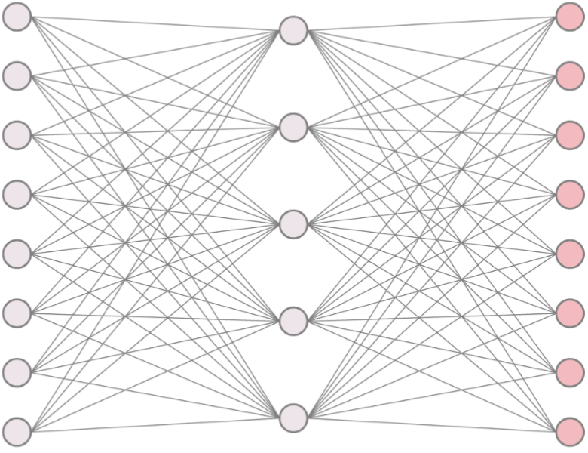
Word2Vec using Skip-gram Architecture
Skip-gram Neural Network Model
NN with single hidden layer
Often used for auto-encoder to compress input vector in hidden layer

Slide 93
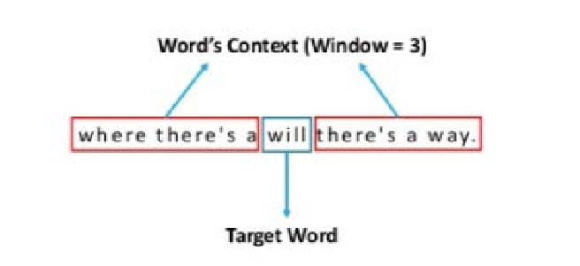
Main idea of Word2Vec
Consider a local window of a target word
Predict neighbors of a target word using skip-gram model

Slide 94

Collection of Training samples with a window of size 2

Slide 95
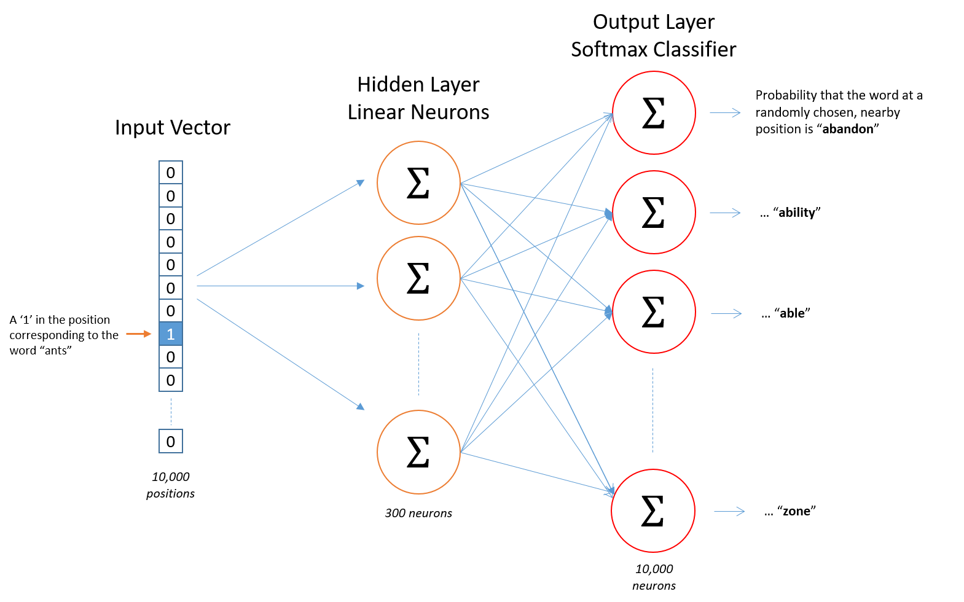
Skip-gram Architecture

Slide 96
Word Embedding
Build a vocabulary of words from training documents
E.g.) a vocabulary of 10,000 unique words
Represent an input word like “ants” as a one-hot vector
This vector will have 10,000 components (one for every word in our vocabulary)
This vector will have “1” in the position corresponding to the word, say “ants”, and 0s in all of the other positions.

Slide 97
Word Embedding
No activation function for hidden layer neurons, but output neurons use softmax
When training the network with word pairs, the input is a one-hot vector representing the input word and output is also a one-hot vector representing the output word.
when evaluating the trained network on an input word, the output vector will actually be a probability distribution (i.e., a bunch of floating point values, not a one-hot vector).
Notes:
隠れ層ニューロンには活性化関数はないが、出力ニューロンはソフトマックス関数を使用する
単語のペアでネットワークをトレーニングする場合、入力は入力単語を表す1つのホットベクトルであり、出力も出力単語を表す1つのホットベクトルです。
トレーニング済みのネットワークを入力単語で評価する場合、出力ベクトルは実際には確率分布（すなわち、1つのホットベクトルではなく、浮動小数点値の集合）となります。

Slide 98
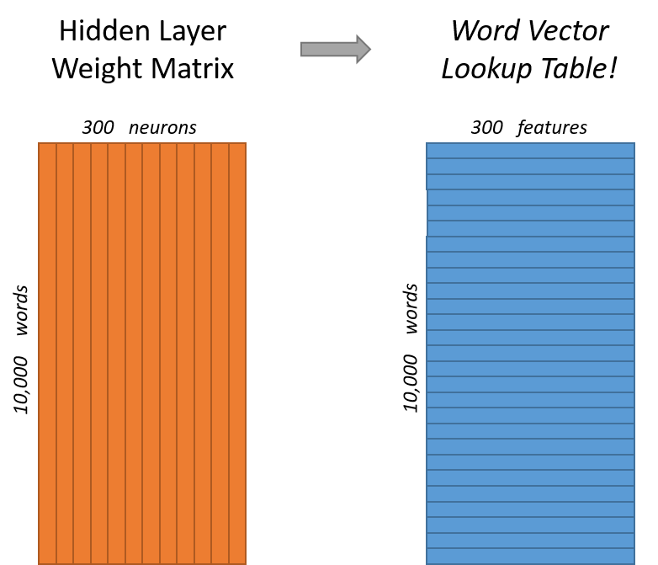
Word Embedding
Hidden layer is represented by a weight matrix with 10,000 rows (one for every word in our vocabulary) and 300 columns (one for every hidden neuron)
300 features for Google News Dataset
rows of this weight matrix are actually what will be our word vectors!
Notes:
隠れ層は、1万行（語彙のすべての単語に対応）300列（すべての隠れニューロンに対応）の重み行列で表されます
Googleニュースデータセットの300の特徴
この重み行列の行が、実際に単語ベクトルとなります！

Slide 99
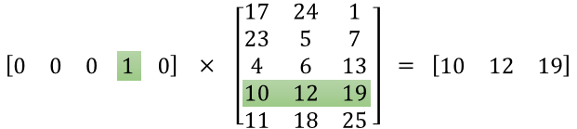
Word Embedding
If we multiply a 1 x 10,000 one-hot vector by a 10,000 x 300 matrix, it will effectively just select the matrix row corresponding to the “1”
Hidden layer is really just operating as a lookup table !!
The output of the hidden layer is just the “word vector” for the input word
Notes:
1 x 10,000 のワンホットベクトルを 10,000 x 300 の行列で乗算すると、実質的には「1」に対応する行列の行が選択されるだけです
隠れ層は、実際にはルックアップテーブルとして動作しているだけなのです！隠れ層の出力は、入力された単語の「単語ベクトル」にすぎません。

Slide 100
Word Embedding
The output layer is a softmax regression classifier
It produces an output between 0 and 1, and the sum of all these output values will add up to 1
each output neuron has a weight vector which it multiplies against the word vector from the hidden layer, then it applies the function exp(x) to the result. Finally, in order to get the outputs to sum up to 1, we divide this result by the sum of the results from all 10,000 output nodes
Notes:
出力層はソフトマックス回帰分類器です。
0から1の間の値を出力し、これらの出力値の合計は1になります。
各出力ニューロンには重みベクトルがあり、隠れ層からの単語ベクトルと掛け合わせ、その結果に exp(x) という関数を適用します。最後に、出力を合計して1にするために、この結果を10,000個の出力ノードからの結果の合計で割ります。

Slide 101
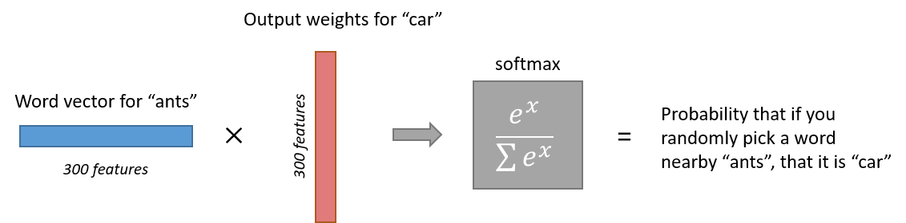
Word Embedding

Slide 102
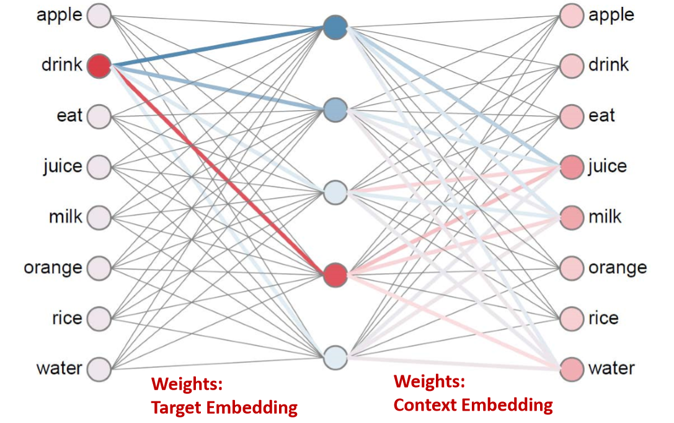
Word Embedding

Slide 103
Negative sampling for Skip-gram
Softmax function requires too much computation for its denominator (say, summation of 10000 terms)
When training, negative sampling considers only a small number of negative words (let’s say 5) including the positive word for this summation
“negative” word is one for which network outputs “0” and “positive” word is one for which network outputs “1”
Notes:
ソフトマックス関数では、分母の計算（例えば10000項の総和）に膨大な計算が必要となる
トレーニングの際、負のサンプリングでは、この総和の正の単語を含む少数の負の単語（例えば5つ）のみを考慮する
「負」の単語とは、ネットワークの出力が「0」となる単語であり、「正」の単語とは、ネットワークの出力が「1」となる単語である

Slide 104
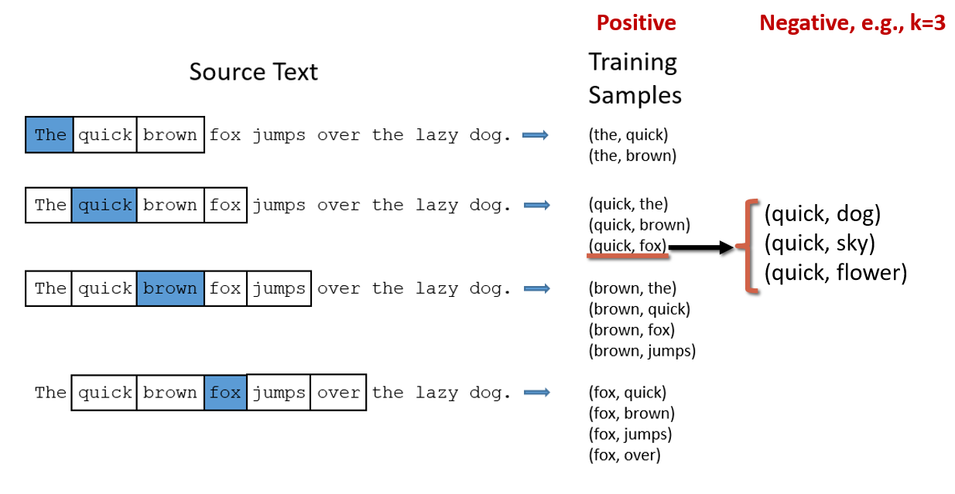
Negative sampling for Skip-gram

Slide 105

A Potential Application
Relation detection

Slide 106
Multi-Dimensional Scaling
Map the items in a k-dimensional space trying to minimize the stress
Steepest Descent algorithm:
Start with an assignment
Minimize stress by moving points
But the running time is O(N2) and O(N) to add a new item

Slide 107
Multidimensional Scaling (MDS): What Is It?
Generally regarded as exploratory data analysis (Ding, 2006).
Reduces large amounts of data into easy-to-visualize structures.
Attempts to find structure (visual representation) in a set of distance measures, e.g. dis/similarities, between objects/cases.
Shows how variables/objects are related perceptually.
How? By assigning cases to specific locations in space.
Distances between points in space match dis/similarities as closely as possible:
Similar objects: Close points Dissimilar objects: Far apart points
Notes:
-MDS is part of family of models called Multidimensional Analyses (MDA), consisting of factor and principle component analysis; these are statistical techniques employed in exploratory data analysis.

Slide 108

MDS Example: City Distances
Distances
Matrix:
Symmetric
Cluster
Spatial Map
Dimensions
1: North/South
2: East/West
Notes:
-Before plunging into the details of MDS, we’d first like to introduce how its input and output look like with a very basic, intuitive example. This example is used repeatedly to illustrate how MDS works.
-The data matrix can be called many different things: Proximity matrix, distance matrix, similarity/dissimilarity matrix: dependent on what data is collected and how it is collected.
-In this particular case, I’m calling it a distances matrix because it reflects the actual physical distances between the cities (in miles). It’s symmetric - 9 columns by 9 rows because every city is compared with every other city. Most MDS scenarios generally consist of symmetric data such as this.
-Out of the distances matrix, a spatial map is constructed. Again, the map cal be called many different things: a perceptual map, a spatial representation, among others.
-The spatial map is a representation of the distances between the cities entered into the matrix.
-Cities that are physically distant from one another are furthest apart on the map.
-Further, cities that are physically close form clusters on the map.
-Another component of the map is the extraction of dimensions, underlying commonalities/themes within the map. In this case, two dimensions were extracted and correspond to geographical directions. Dimension 2 represents E/W while Dimension 1 is N/S.

Slide 109
The Process of MDS: The Data
Data of MDS: similarities, dissimilarities, distances, or proximities reflects amount of dis/similarity or distance between pairs of objects.
Distinction between similarity and dissimilarity data dependent on type of scale used:
⇒Dissimilarity scale: Low #=high similarity &
High #=high dissimilarity.
⇒Similarity scale: Opposite of dissimilarity.
E.g. On a scale of 1-9 (1 being the same and 9 completely different) how similar are chocolate bars A and B? Dissimilarity scale.
Notes:
-Now that everyone has a really basic idea of what MDS is about, we can proceed to the nitty-gritty of MDS/the process of MDS.
-Logically, we’ll first asses what kid of data is appropriate for MDS.
-The data of MDS is called many different terms - these may be used interchangeably, although some terms seem more logical in certain cases. For instance, in the cities distance example, its logical to refer to the data as distances because that’s what it is. But it could have been referred to as dissimilarities.
-That being said, there actually is a distinction between similarity and dissimilarity date

Slide 110
Data Collection for MDS (1)
Direct/raw data: Proximities’ values directly obtained from empirical, subjective scaling.
E.g. Rating or ranking dis/similarities (Likert scales).
Indirect/derived data: Computed from other measurements: correlations or confusion data (based on mistakes) (Davidson, 1983).
E.g. Letters of alphabet presented briefly and must be identified. Rarely confused letters given high dissimilarity values, those that are confused get low values.
Data collection: Pairwise comparison, grouping/sorting tasks, direct ranking, objective method (e.g. city distances).
Pairwise comparisons: All object pairs randomly presented:
# of pairs = n(n-1)/2, n = # of objects/cases
Can be tedious and inefficient process.
Notes:
-Direct data is the most commonly used data in MDS and the data that we will primarily be discussing.
-Pairwise comparisons are quite common in psychological research involving MDS.

Slide 111

Data Collection for MDS (2)
Facilitation of pairwise comparison task:
1) Incomplete similarity task: random or cyclic deletion of comparison pairs.
2) Simplification of pair comparisons (binary scale).
3) Choosing grouping/sorting tasks (Tsogo et al., 2000).
⇒Pre-specified # of groups or not specified.
Appropriateness of a data collection technique is dependent on stimuli and, in some cases, “hypothesis” and theory.
Notes:
-Cyclic deletion refers to a more systematic approach to deleting pairs from comparison.
-Simplification of the ask by choosing a simpler scale should presumably expedite the task.
-Another commonly used technique within psychology is the grouping/sorting task where you don’t ask participants to make pairwise comparisons between every object but instead ask your participants to group stimuli according to a prespecified number of groups, or not. However, the participant is not instructed on the type of groups to create - this is left to the discretion of the participant.
-Pariwise comparisons are probably easily done in tones while sorting tasks may be more appropriate for phrases/concepts.

Slide 112
Type of MDS Models (1)
MDS model classified according to:
1) Type of proximities:
Metric/quantitative: Quantitative information/interval data about objects’ proximities e.g. city distance.
Non-metric/qualitative: Qualitative information/nominal data about proximities e.g. rank order.
2) Number of proximity matrices (distance, dis/similarity matrix).
Proximity matrix is the input for MDS.
The above criteria yield:
1) Classical MDS: One proximity matrix (metric or non-metric).
2) Replicated MDS: Several matrices.
3) Weighted MDS/Individual Difference Scaling: Aggregate proximities and individual differences in a common MDS space.

Slide 113

Types of MDS (2)
More typical in Social Sciences is the classification of MDS based on nature of responses:
Decompositional MDS: Subjects rate objects on an overall basis, an “impression,” without reference to objective attributes.
Production of a spatial configuration for an individual and a composite map for group.
Compositional MDS: Subjects rate objects on a variety of specific, pre-specified attributes (e.g. size).
No maps for individuals, only composite maps.
Notes:
-There is another means of classifying MDS models this one is more broadly classified according to the nature of the responses.
-The decompositional MDS is more typical in social sciences

Slide 114


The MDS Model
Classical MDS uses Euclidean principles to model data proximities in geometrical space, where distance (dij) between points i and j is defined as:
xi and xj specify coordinates of points i and j on dimension a, respectively.
The modeled Euclidean distances are related to the observed proximities, δij, by some transformation/function (f).
Most MDS models assume that the data have the form:
δij = f(dij)
All MDS algorithms are a variation of the above (Davidson, 1983).
Notes:
-Euclidean refers to specific geometrical principles
-The model assumes that the proximities are directly related to the distances on the geometrical map.
-The information is a very simplified presentation of the math actually involved in creation of the MDS map and more detailed mathematical explanations are certainly available.

Slide 115

Output of MDS
MDS Map/Perceptual Map/Spatial Representation:
1) Clusters: Groupings in a MDS spatial representation.
These may represent a domain/subdomain.
2) Dimensions: Hidden structures in data. Ordered groupings that explain similarity between items.
Axes are meaningless and orientation is arbitrary.
In theory, there is no limit to the number of dimensions.
In reality, the number of dimensions that can be perceived and interpreted is limited.
Notes:
-As was demonstrated in the cities distance example, the output of MDS is a MDS map.
-Many of these terms also came up during the presentation of the example, we now address them in more detail.
-Axes of the MDS map are meaningless and the orientation is arbitrary even though in the example of the cities, there was a logical layout to the cities; their layout on the MDS map corresponded with their geographical positions.
-By default, a 2-D solution is provided by SPSS.

Slide 116

Diagnostics of MDS (1)
MDS attempts to find a spatial configuration X such
that the following is true: f(δij) ≈ dij(X)
Stress (Kruskal’s) function: Measures degree of correspondence between distances among points on the MDS map and the matrix input.
⇒Proportion of variance of disparities
not accounted for by the model:
Range 0-1: Smaller stress = better representation.
None-zero stress: Some/all distances in the map are distortions of the input data.
Rule of thumb: ≤0.1 is excellent; ≥0.15 not tolerable.
Notes:
-SPSS, by default, uses Kruskal’s function of stress, although other forms of stress do exist.

Slide 117
Diagnostics of MDS (2)
R2 (RSQ): Proportion of variance of the disparities accounted for by the MDS procedure.
R2≥0.6 is an acceptable fit.
Weirdness Index: Correspondence of subject’s map and the aggregate map ⇒ outlier identification.
Range 0-1: 0 indicates that subject’s weights are proportional to the average subject’s weights; as the subject’s score becomes more extreme, index approaches 1.
Shepard Diagram: Scatterplot of input proximities (X-axis) against output distances (Y-axis) for every pair of items.
Step-line produced. If map distances fall on the step-line this indicates that input proximities are perfectly reproduced by the MDS model (dimensional solution).
Notes:
Homogeneity of the respondents’ perceptions - weights.

Slide 118

Interpretation of Dimensions
Squeezing data into 2-D enables “readability” but may not be appropriate: Poor, distorted representation of the data (high stress).
Scree plot: Stress vs.
number of dimensions.
E.g. cities distance
Primary objective in dimension interpretation: Obtain best fit with the smallest number of possible dimensions.
How does one assign “meaning” to dimensions?
Notes:
-Scree plot can be used to assess how many dimensions should be extracted/are appropriate. This occurs when the rate of stress no longer changes dramatically with increased number of dimensions. Put in another way, this occurs when there is an “elbow” within the scree plot.

Slide 119
Meaning of Dimensions
Subjective Procedures:
Labelling the dimensions by visual inspection, subjective interpretation, and information from respondents.
“Experts” evaluate and identify the dimensions.
Notes:
-It makes sense to assess the outputs of compositional by validating against other measures of perception because the positions are totally defined by the attributes specified by the researcher.

Slide 120
Validating MDS Results
Split-sample comparison:
Original sample is divided and a correlation between the variables is conducted.
Multi-sample comparison:
New sample is collected and a correlation is conducted between the old and new data.
Comparisons are done visually or with a simple correlation of coordinates or variables.
Assessing whether MDS solution (dimensionality extraction) changes in a substantial way.
Notes:
Checked through correlation analysis.

Slide 121


MDS Caveats
Respondents probably perceive stimuli differently. In non-aggregate data, different dimensions may emerge.
Respondents may attach different levels of importance to a dimension.
Importance of a dimension may change over time.
Interpretation of dimensions is subjective.
Generally, more than four times as many objects as dimensions should be compared for the MDS model to be stable.
Notes:
-Point number one is really a point that is applicable to all statistical methods. After all, in the GLM, the scores of one individual may be far from the mean. This is why we use many individuals to construct the mean. As such a dimensional map of one individual may not necessarily reflect the MDS map that comes about from aggregate data.

Slide 122
“Advantages” of MDS
An alternative to the GLM.
Does not require assumptions of linearity, metricity, or multivariate normality.
Can be used to model nonlinear relationships.
Dimensionality “solution” can be obtained from individuals; gives insight into how individuals differ from aggregate data.
Reveals dimensions without the need for defined attributes.
Dimensions that emerge from MDS can be incorporated into regression analysis to assess their relationship with other variables.
Notes:
-GLM: bias towards utilizing quantitative data and to strong measurement assumptions about the data.
-Hence, MDS is more flexible than then GLM.
-With respect to point 5: it is like providing the dependent variable (similarity among objects) and figuring out what the independent variables (perceptual dimension) must be.

Slide 123
tSNE to the rescue…
T-Distributed Stochastic Neighbour Embedding
Aims to solve the problems of PCA
Non-linear scaling to represent changes at different levels
Optimal separation in 2-dimensions

Slide 124


How does tSNE work?
Based around all-vs-all table of pairwise cell to cell distances

Slide 125

Distance scaling and perplexity
Perplexity = expected number of neighbours within a cluster
Distances scaled relative to perplexity neighbours

Slide 126



Perplexity Robustness

Slide 127
tSNE Projection
Normally 2D, but can be any number of dimensions
Randomly scatter all points within the space
Start a simulation
Aim is to make the point distances match the distance matrix
Shuffle points based on how well they match
Stop after fixed number of iterations, or
Stop after distances have converged

Slide 128





tSNE Projection
X and Y don’t mean anything (unlike PCA)
Distance doesn’t mean anything (unlike PCA)
Close proximity is highly informative
Distant proximity isn’t very interesting
Can’t rationalise distances, or add in more data

Slide 129




tSNE Practical Examples
Perplexity Settings Matter
Original
Perplexity = 2
Perplexity = 30
Perplexity = 100
https://distill.pub/2016/misread-tsne/

Slide 130




tSNE Practical Examples
Cluster Sizes are Meaningless
Original
Perplexity = 2
Perplexity = 5
Perplexity = 50
https://distill.pub/2016/misread-tsne/

Slide 131




tSNE Practical Examples
Distances between clusters can’t be trusted
Original
Perplexity = 2
Perplexity = 5
Perplexity = 30
https://distill.pub/2016/misread-tsne/

Slide 132


So tSNE is great then?
Kind of…
Imagine a dataset with only one super informative gene
Now 3 genes
Now 3,000 genes
Everything is the same distance from everything
Distance within cluster = low
Distance between clusters = high
Distance within cluster = higher
Distance between clusters = lower

Slide 133
So everything sucks?
PCA
Requires more than 2 dimensions
Thrown off by quantised data
Expects linear relationships
tSNE
Can’t cope with noisy data
Loses the ability to cluster
Answer: Combine the two methods, get the best of both worlds
PCA
Good at extracting signal from noise
Extracts informative dimensions
tSNE
Can reduce to 2D well
Can cope with non-linear scaling
This is what CellRanger does in its default analysis

Slide 134
So PCA + tSNE is great then?
Kind of…
tSNE is slow. This is probably it’s biggest crime
tSNE doesn’t scale well to large numbers of cells (10k+)
tSNE only gives reliable information on the closest neighbours large distance information is almost irrelevant

Slide 135
UMAP to the rescue!
UMAP is a replacement for tSNE to fulfil the same role
Conceptually very similar to tSNE, but with a couple of relevant (and somewhat technical) changes
Practical outcome is:
UMAP is quite a bit quicker than tSNE
UMAP can preserve more global structure than tSNE*
UMAP can run on raw data without PCA preprocessing*
UMAP can allow new data to be added to an existing projection
* In theory, but possibly not in practice

Slide 136
UMAP differences
Instead of the single perplexity value in tSNE, UMAP defines
Nearest neighbours: the number of expected nearest neighbours – basically the same concept as perplexity
Minimum distance: how tightly UMAP packs points which are close together
Nearest neighbours will affect the influence given to global vs local information. Min dist will affect how compactly packed the local parts of the plot are.

Slide 137
UMAP differences
Speed – mostly a level of maths I’m not going to get into!
UMAP skips a normalisation step in the calculation of high dimensional distances which speeds it up
In the 2D projection UMAP uses a more efficient method to shuffle the cells into their final position
Doesn’t have to measure every cell to decide on what to move
Uses an algorithm which can be multi-threaded
Algorithm is more deterministic, allowing more data to be projected later

Slide 138


UMAP differences
Structure preservation – mostly in the 2D projection scoring
Scoring
(penalty)
value
Distance in
projected data
Distance in
original data
tSNE
UMAP
https://towardsdatascience.com/how-exactly-umap-works-13e3040e1668

Slide 139

So UMAP is great then?
Kind of…
tSNE
UMAP

Slide 140


So UMAP is great then?
Kind of…
It may perform better on more complex datasets
It’s certainly quicker
https://pair-code.github.io/understanding-umap/

Slide 141

So UMAP is all hype then?
No, it really does better for some datasets…
3D mammoth skeleton projected into 2D
tSNE: Perplexity 2000 2h 5min
UMAP: Nneigh 200, mindist 0.25, 3min
https://pair-code.github.io/understanding-umap/

Slide 142
Practical approach PCA + tSNE/UMAP
Filter heavily before starting
Nicely behaving cells
Expressed genes
Variable genes
Do PCA
Extract most interesting signal
Take top PCs. Reduce dimensionality (but not to 2)
Do tSNE/UMAP
Calculate distances from PCA projections
Scale distances and project into 2-dimensions

